Slide 1

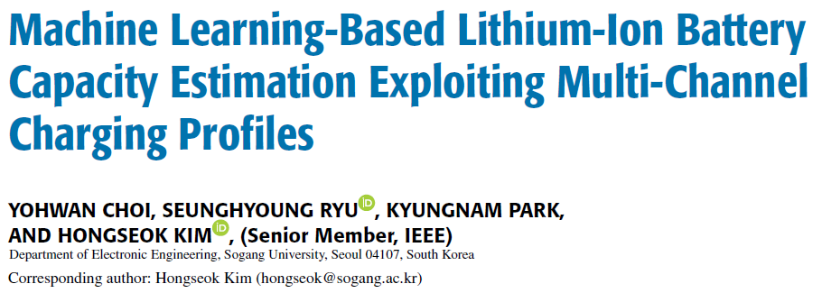
Convolutional Neural Network – NASA Battery Dataset
Presented by: Bramantio Yuwono

Slide 2
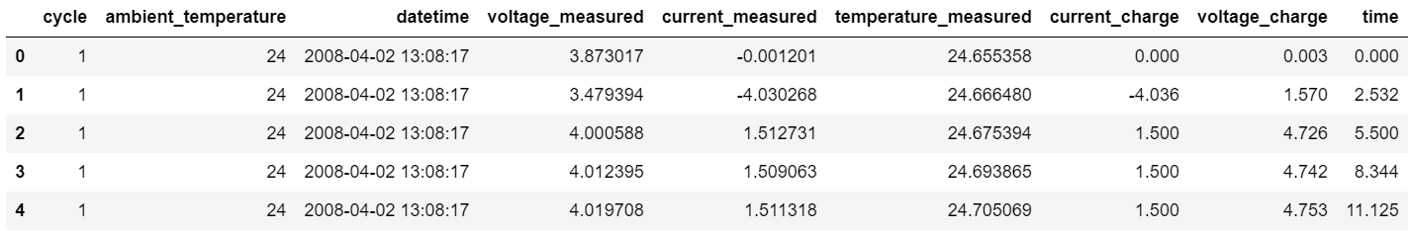
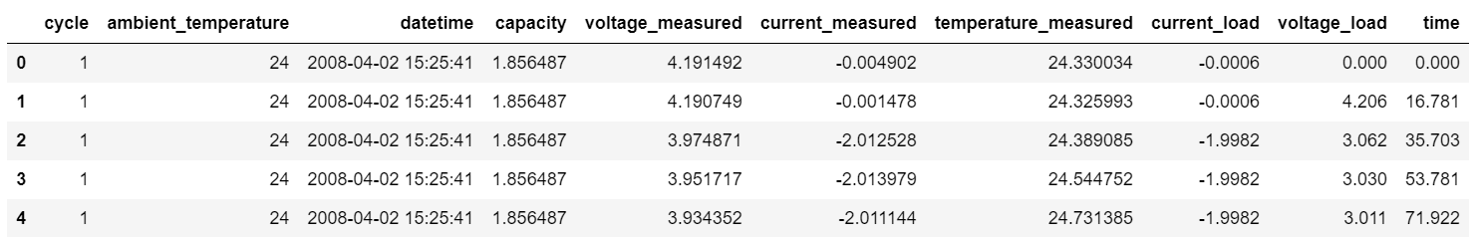
Dataset: Li-ion Battery Aging Datasets
Data of battery parameters after being run through 3 different operational profiles (charge, discharge, and impedance) until the batteries reach the end-of-line (EOL) criteria of 30% fade in rated capacity.
Dataset for Charge Operation:
Dataset for Discharge Operation:

Slide 3
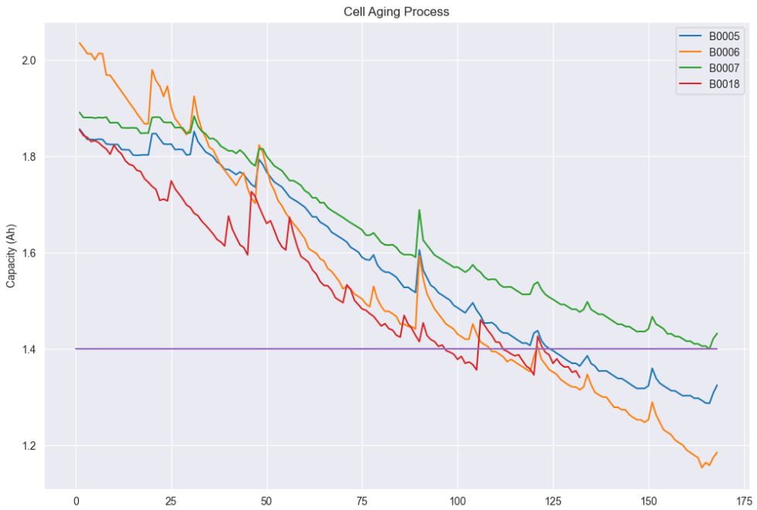

Cell Aging Process

Slide 4

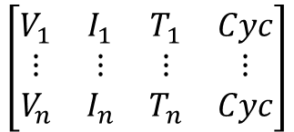





Data Preprocessing
$$\left[\begin{matrix}V & I & \begin{matrix}T & Cyc\end{matrix}\end{matrix}\right]$$
$$\left[\begin{matrix}V & I & \begin{matrix}T & Cyc\end{matrix}\end{matrix}\right]$$
Extract V, I, T
B0005
B0006
B0007
B0018
$$\left[SoH\right]$$
Append
MinMax
Scaling
$$\left[SoH\right]$$
Extract SoH
Normalized
Sample n data for each cycle
N=10
For every cycle of all cells
$$\left[\begin{matrix}V_{1} & … & \begin{matrix}I_{1} & \begin{matrix}… & … & Cyc\end{matrix}\end{matrix}\end{matrix}\right]$$
$$\left[\begin{matrix}\begin{matrix}V_{1} \\ ⋮ \\ V_{n}\end{matrix} & \begin{matrix}\begin{matrix}I_{1} \\ ⋮ \\ I_{n}\end{matrix} & \begin{matrix}T_{1} \\ ⋮ \\ T_{n}\end{matrix} & \begin{matrix}Cyc \\ ⋮ \\ Cyc\end{matrix}\end{matrix}\end{matrix}\right]$$
Reshape
(1 x 4n x 1)
Append
Extract SoH
For every cycle of all cells
Input
Output

Slide 5
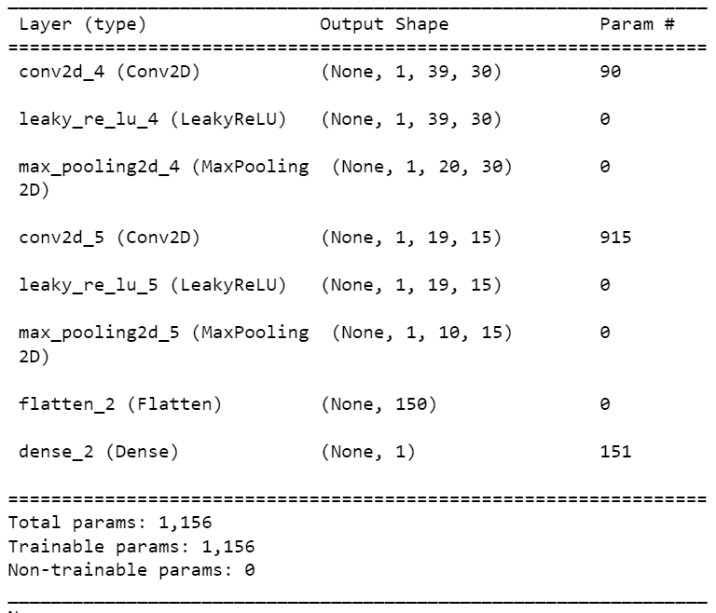
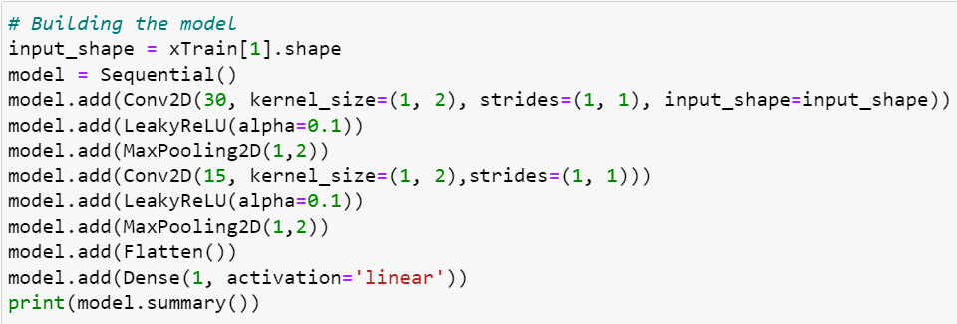
Convolutional Neural Network
Convolution layer: Extracting features from data
Leaky ReLu: Has a small slope for negative values. speeds up training. Fixes the “the dying ReLu” problem as it doesn’t have zero-slope parts.
Max Pooling: Reducing the spatial size of convolved features. Obtain max value from the pool size.
Flatten: Flattened output to be fed to a feed-forward neural network
Dense: Regular densely-connected NN layer

Slide 6
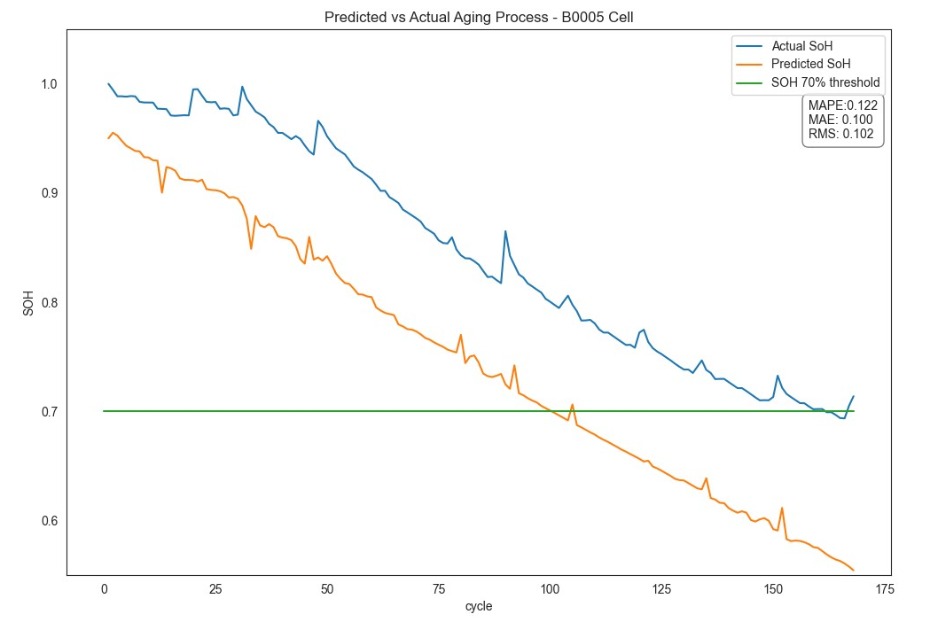
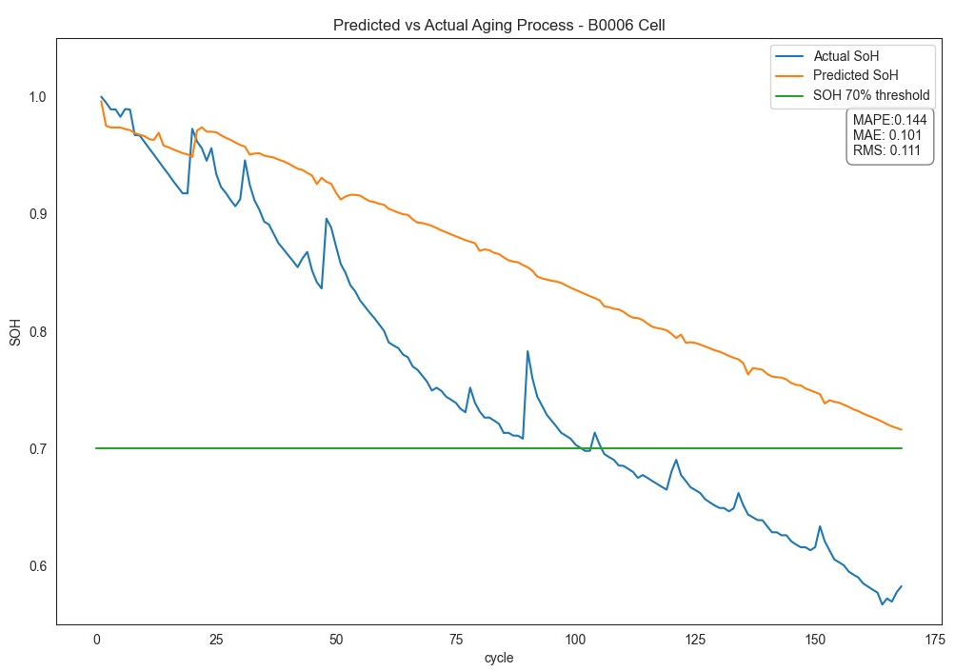
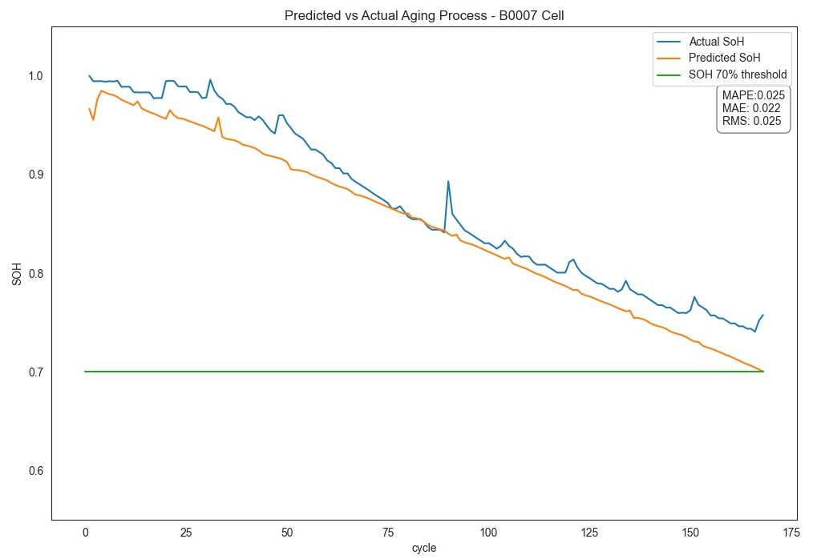
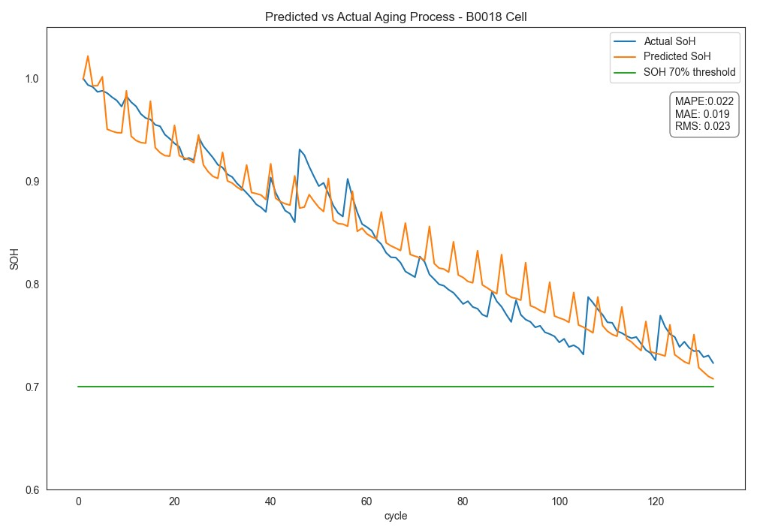



Estimation Results
Averaged Estimation Accuracy:
MAPE = 7.825%
MAE = 0.0605
RMS = 0.06525
Estimation Accuracy from ref:
MAPE = 4.4187%
MAE = 0.0687
RMS = 0.0766

Slide 7
fin

